Slide 1
WEB DEVELOPMENT
BOOTCAMP
2024, Summer. Hashemi Nejad 1 middle School

Slide 2
Syllabus of This Bootcamp
01
02
03
How Internet works?
The main points of Intenet mechanism and the progress of file combining
HTML & CSS
Using HTML to build web pages, Learning CSS for styling web pages
CSS Extras
Learining CSS Grid and Flexbox, Using tailwind CSS framework

Slide 3
Exactly here, 8:30-10, Mon and Wed, in 15 lenghts 90mins sections
Up running task...
GIT Bash...
</
/>
} /> [
How this course will take plce?

Slide 4
WHO AM I? A short introduction
Probably you know me, but I have to do it…

Slide 5
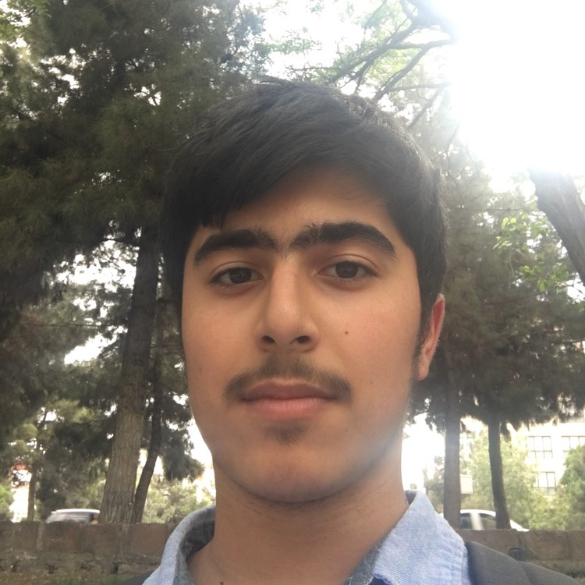
EDUCATION- EXPERIENCE
Proffeciencies
Amirtaha Afkhami
Stacks
Web and AI developer
MAIN SKILLS
Education
Mathematics, 11th grade, Hashemi Nejad 1
FISO International Math Olympiad of USA, Gold Award
Stanford Algorithmic proccession, Silver Award
90%
80%
80%
Front
React
Node
Experience
Peyghoom, Neuron, PRS Front-end developer
Better AI Navigation manager
80%
75%
75%
Python
AI
SQL
MERN
90%
+98 915 377 38 22 amirtahaafkhami.tech@gmail.com
Python
80%
Soft apps
Management

Slide 6
01 {
[Theory Lesson]:
section1.html
section2.html
<
- How Internet and websites works
- common words in programming
- applications
- How to take most out of this course?
- problem solving strategies
- effective rules
>
}
Introduction, Basics

Slide 7
Internet?

Slide 8

Here are three ideas
...
Internet is a long WIRE!!!
CLOUD?!
A CODE?!

Slide 9

How this WIRE works???
Server, Client, ISP, DNS

Slide 10



END RESPONSE???

Slide 11
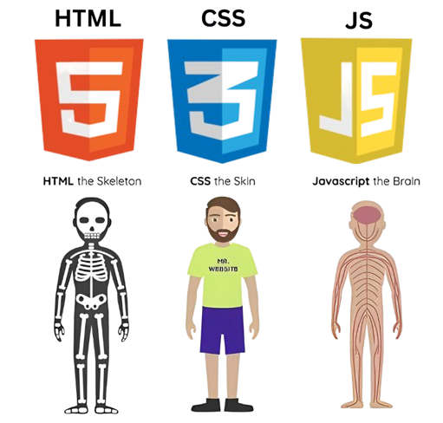

Slide 12
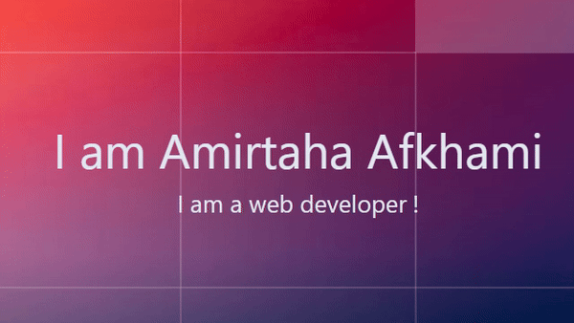

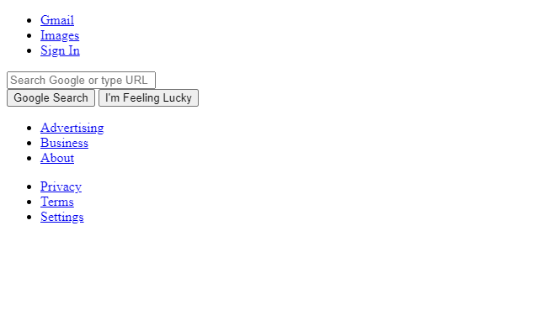
Let’s see!
{
}
...

Slide 13
—YOU’LL SEE THIS WORDS A LOT
“IDE, text editor, library, framework, compile, interpretation, programming language”

Slide 14
if situation === ‘stuck’ {
Listen Me!
stuck.css
Step 01
READ YOUR CODE! Usually bugs and errors are just a typo.
Step 02
SEARCH! Lots of people had your problem before!
Step 03
Send a message in group! (I’ll help you if I could figure the problem out 😊)
Step 04
Bang your head through a rough wall😁. Send your error somewhere!
}

Slide 15


Apps!

Slide 16
Here are six advices
{
..
There’s no the best
programming language!
Prepare your mind
before coding!
Try to code as a habit.
No problem with
saying “don’t know”!
Keep Learning
Break someone
else’s code!
*
}
..

Slide 17
Question?
First session is over…

